Slide 1
Big Mountain Resort:
Analysis and Suggestions
Nicole Coomer 9/12/2021

Slide 2
Problem Identification
Context
Big Mountain Resort is a ski resort located in Montana that offers memorable outdoor adventures to its consumers. The resort would like to know how to value their experiences while either cutting costs or raising ticket prices.
Hypothesis
Is it possible for Big Mountain Resort to either increase its ticket prices or cut costs by at least 20% in one ski season by employing a new market positioning strategy that highlights their key differentiators as compared to resorts of the same market share?

Slide 3
Recommendations and key findings
While the resort currently charges adult weekend visitors $81 per ticket, the resort’s modelled price is $95.87. This means that even with an expected mean absolute error of $10.39, there is room for a price increase.
As far as cost cutting and price increases, we found that closing up to 4 or 5 of the least used runs makes no difference in ticket price.
Another area of opportunity is the idea of adding a run, increasing vertical drop by 150 feet, and installing a chair lift. This would support a ticket price increase of 8.61 and amount to $15,065,471 over the season.

Slide 4
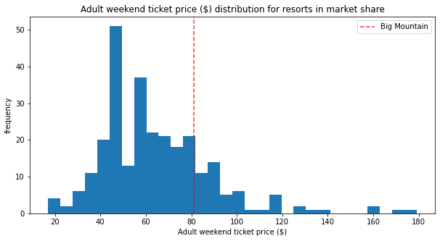
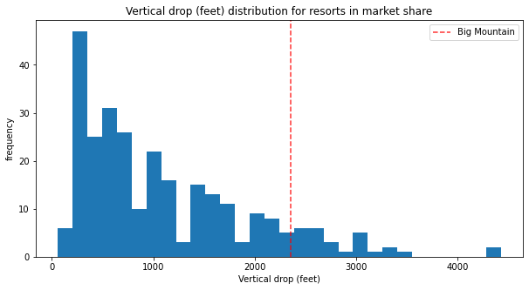
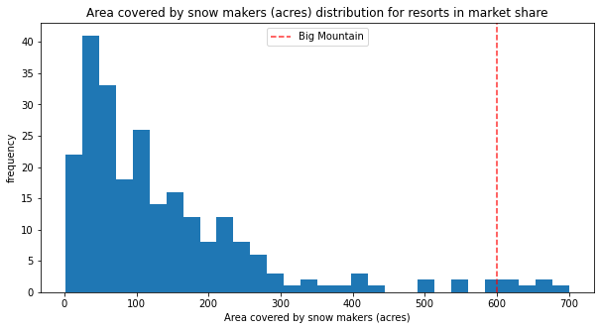
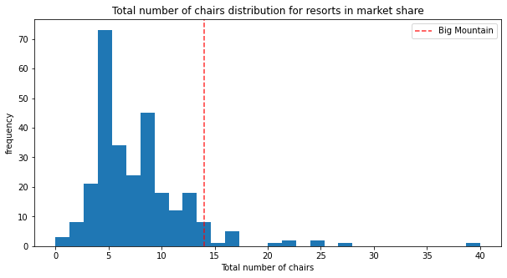
Modeling Results
Ticket Pricing
Vertical Drop
Snow Making Area
Total Number of Chairs

Slide 5
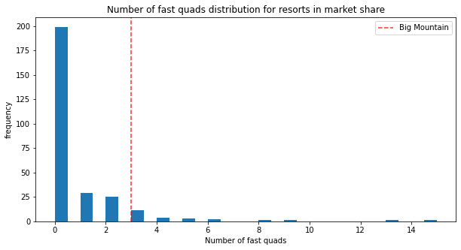
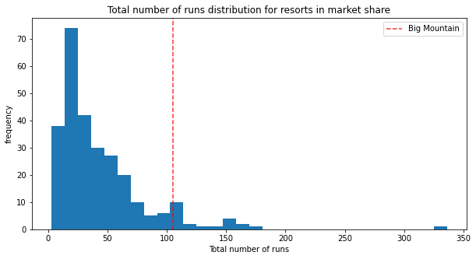
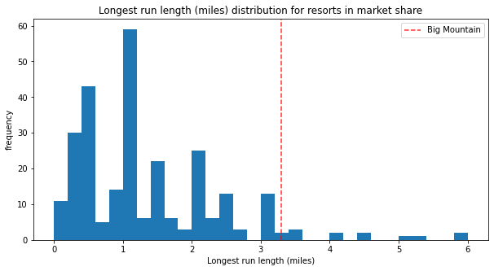
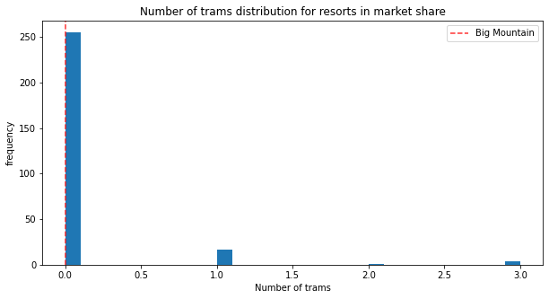
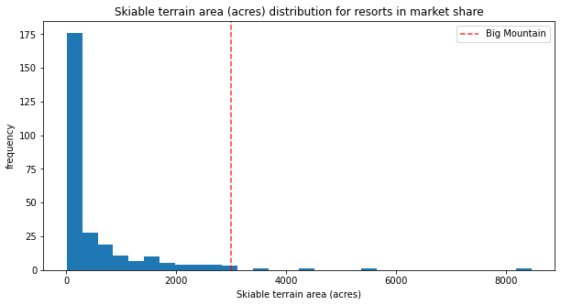
Modeling Results
Fast Quads
Runs
Longest Run
Trams
Skiable Terrian Area

Slide 6
Analysis of Four Scenarios
In the first scenario, we found that closing up to 4 or 5 of the least used runs makes no difference in ticket price.
In the second scenario, Big Mountain adds a run, increasing vertical drop by 150 feet and installing a chair lift. This would support a ticket price increase of $8.61 and amount to $15,065,471 over the season.
In the third scenario, Big Mountain adds 2 acres of snow making on top of the changes made in scenario 2. This amounts to support for increasing the ticket cost by $9.90 and $17,322,717 over the season.
The fourth scenario increases the longest run by .2 miles and guarantees snow coverage by adding 4 acres of snow.

Slide 7
Conclusion
Scenarios 1 & 2
In my opinion, scenarios 1 and 2 need further exploration. Scenario 1, in which some runs are closed without impact to ticket costs, could potentially free up funds to be directed towards scenario 2, in which we add a run, increase vertical drop by 150 feet, and install an additional chair. This should hopefully cut costs while also zoning in on opportunities to increase revenue.

